Slide 1
Probe Data Analysis for Road Slope
Zhiquan Li
Date: Mar/09/2018

Slide 2

Outlines :
1.
Background and Introduction
2.
Problem Analysis
3.
Proposed Solution
4.
Algorithm Implementation
5.
Conclusions and Findings

Slide 3
Background and Introduction
Nowadays, handled and dashboard-mounted travel guidance devices with embedded GPS have increased dramatically. The GPS trajectory collected by each device has been used in more and more applications, such as traffic flow analysis, geographical social network and so on.
However, the data of GPS trajectory is not precise since there are measure errors in devices and sampling.
Therefore, we need a method to map each GPS position with road network, then we could use these matched data to do further analysis

Slide 4
Problem Analysis
The problem is divided into three parts, which are map-matching, road slope computation and result evaluation.
In map-matching, the GPS trajectory is collected by difference devices in different date, so the map-matching could be done in each device separately.
In slope computation and evaluation, we need to compute link slope with difference of altitude and distance between matched points and reference node, then we need to compare the deviation between the computed slope and the observed slope in the link data

Slide 5
Proposed solution
In map-matching, we could match each GPS trajectory to its corresponding link by doing spatial analysis and temporal analysis, which is to find the highest possibility candidate point for each GPS trajectory in each link. The algorithm is introduced by a paper^{[1]}.
In slope computation and evaluation, we found each link would contain several matched points, so the link slope could be represented by the average slope of all matched points, then we could evaluate the result according the deviation between computed slope and observed slope.

Slide 6
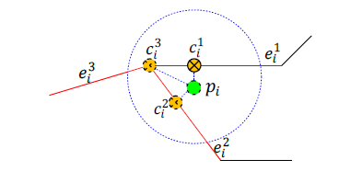
Algorithm Implementation: map-matching
Step 1:
In this step, we selected links within a radius of 20 meters of a GPS point. The reason we choose 20 meters is the paper^{[1]} used a zero-mean normal distribution with standard deviation of 20 meters. Then, we could project a GPS point to each link to find candidate points
Candidate points for a sampling point 𝒑𝒊^{[1]}

Slide 7
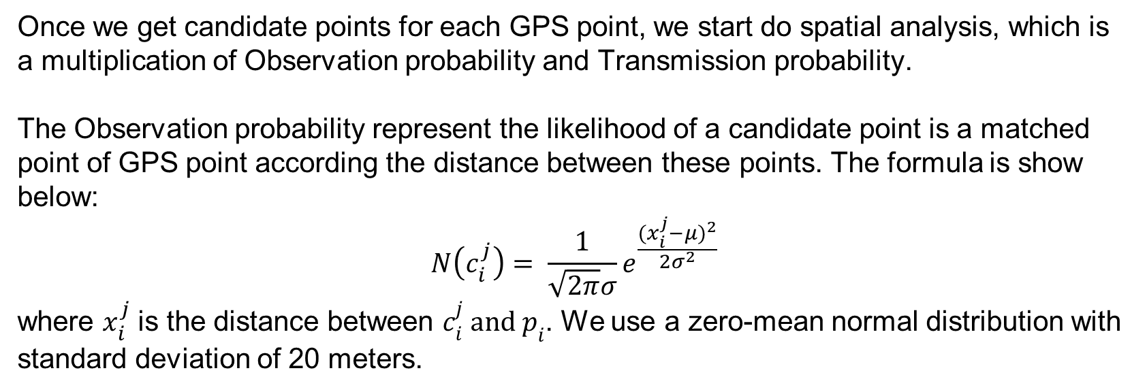
Algorithm Implementation: map-matching
Step 2:
Once we get candidate points for each GPS point, we start do spatial analysis, which is a multiplication of Observation probability and Transmission probability.
The Observation probability represent the likelihood of a candidate point is a matched point of GPS point according the distance between these points. The formula is show below:
$$N\left(c_{i}^{j}\right)= \frac{1}{\sqrt{2π}σ}e^{\frac{{(x_{i}^{j}−μ)}^{2}}{2σ^{2}}}$$
where $x_{i}^{j}$is the distance between $c_{i}^{j} and p_{i}$. We use a zero-mean normal distribution with standard deviation of 20 meters.

Slide 8
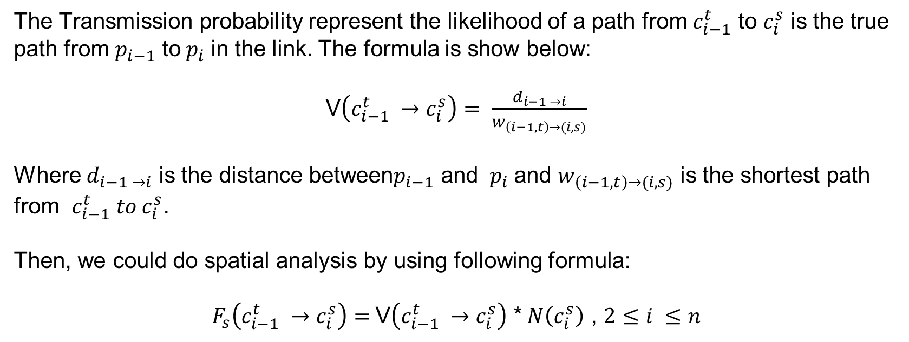
Algorithm Implementation: map-matching
Step 2:
The Transmission probability represent the likelihood of a path from $c_{i−1}^{t}$ to $c_{i}^{s}$ is the true path from $p_{i−1}$ to$p_{i}$ in the link. The formula is show below:
V$\left(c_{i−1}^{t} →c_{i}^{s}\right)= \frac{d_{i−1 →i}}{w_{\left(i−1,t\right)→(i,s)}}$
Where $d_{i−1 →i}$ is the distance between$p_{i−1}$ and $p_{i}$and $w_{\left(i−1,t\right)→(i,s)}$ is the shortest path from $c_{i−1}^{t} to c_{i}^{s}$.
Then, we could do spatial analysis by using following formula:
$F_{s}\left(c_{i−1}^{t} →c_{i}^{s}\right)=$V$\left(c_{i−1}^{t} →c_{i}^{s}\right)$ *$N\left(c_{i}^{s}\right)$ , $2≤i ≤n$

Slide 9
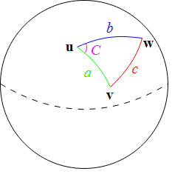
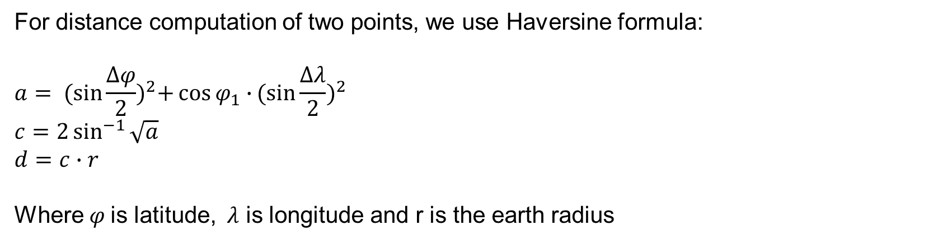
Algorithm Implementation: map-matching
Step 2:
For distance computation of two points, we use Haversine formula:
$$a= {(\sin{\frac{∆φ}{2}})}^{2}+\cos{φ_{1}∙}{(sin{\frac{∆λ}{2}})}^{2}$$
$$c=2\sin^{−1}{\sqrt{a}}$$
$$d=c∙r$$
Where$φ$ is latitude, $λ$ is longitude and r is the earth radius
Spherical triangle solved by the law of haversines

Slide 10
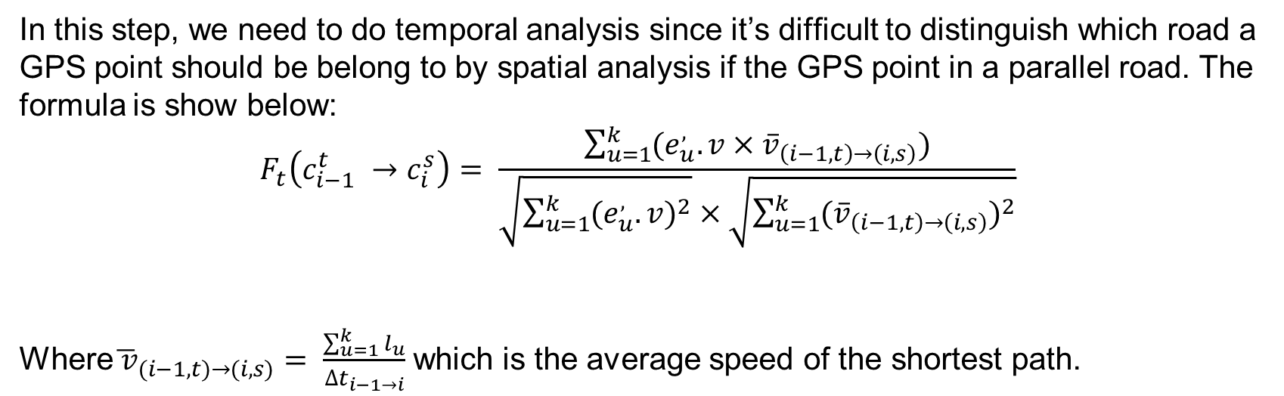
Algorithm Implementation: map-matching
Step 3:
In this step, we need to do temporal analysis since it’s difficult to distinguish which road a GPS point should be belong to by spatial analysis if the GPS point in a parallel road. The formula is show below:
$$F_{t}\left(c_{i−1}^{t} →c_{i}^{s}\right)= \frac{\sum_{u=1}^{k}{(e_{u}^{,}.v×{\overline{v}}_{\left(i−1,t\right)→\left(i,s\right)})}}{\sqrt{\sum_{u=1}^{k}{{(e_{u}^{,}.v)}^{2}}}×\sqrt{\sum_{u=1}^{k}{{({\overline{v}}_{\left(i−1,t\right)→\left(i,s\right)})}^{2}}}}$$
Where${\overline{ v}}_{(i−1,t)→(i,s)}= \frac{\sum_{u=1}^{k}{l_{u}}}{{∆t}_{i−1→i}}$ which is the average speed of the shortest path.

Slide 11
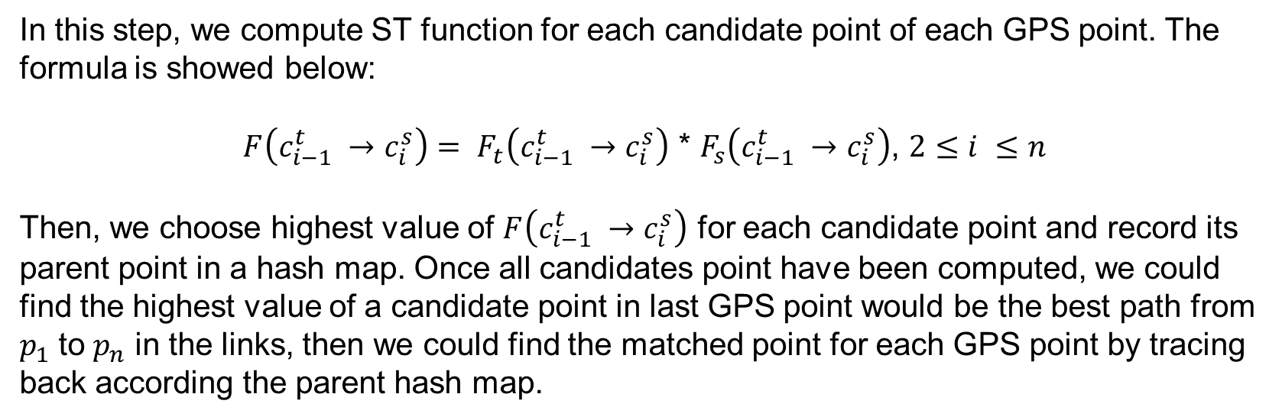
Algorithm Implementation: map-matching
Step 4:
In this step, we compute ST function for each candidate point of each GPS point. The formula is showed below:
$F_{ }\left(c_{i−1}^{t} →c_{i}^{s}\right)= F_{t}\left(c_{i−1}^{t} →c_{i}^{s}\right)$ * $F_{s}\left(c_{i−1}^{t} →c_{i}^{s}\right)$, $2≤i ≤n$
Then, we choose highest value of $F_{ }\left(c_{i−1}^{t} →c_{i}^{s}\right)$ for each candidate point and record its parent point in a hash map. Once all candidates point have been computed, we could find the highest value of a candidate point in last GPS point would be the best path from $p_{1}$ to$p_{n}$ in the links, then we could find the matched point for each GPS point by tracing back according the parent hash map.

Slide 12
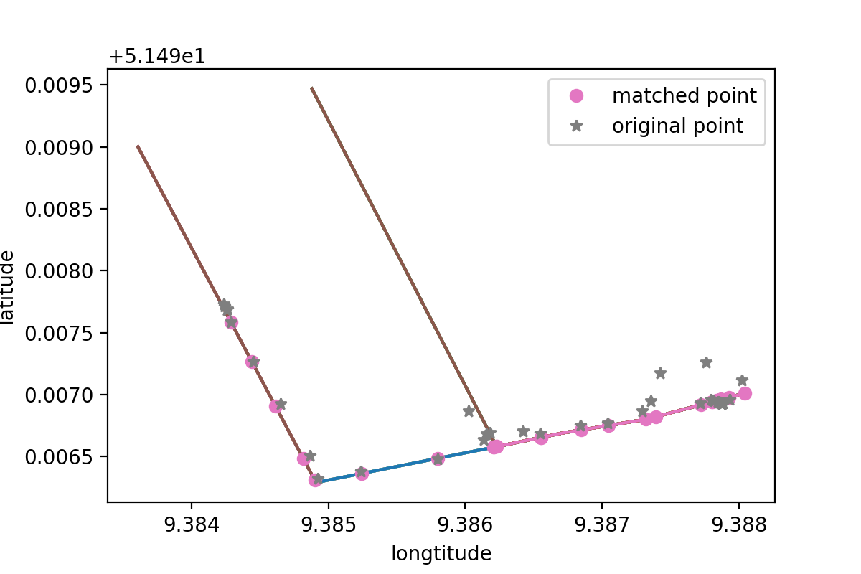
Algorithm Implementation: map-matching
Result of sampleID 3496:
Map-matching result of sampleID 3496

Slide 13
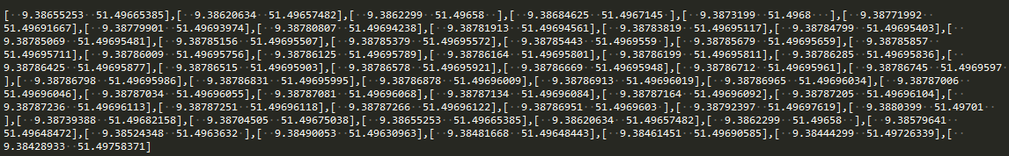
Algorithm Implementation: map-matching
Result of sampleID 3496:
Matched points for probe points with sampleID 3496

Slide 14
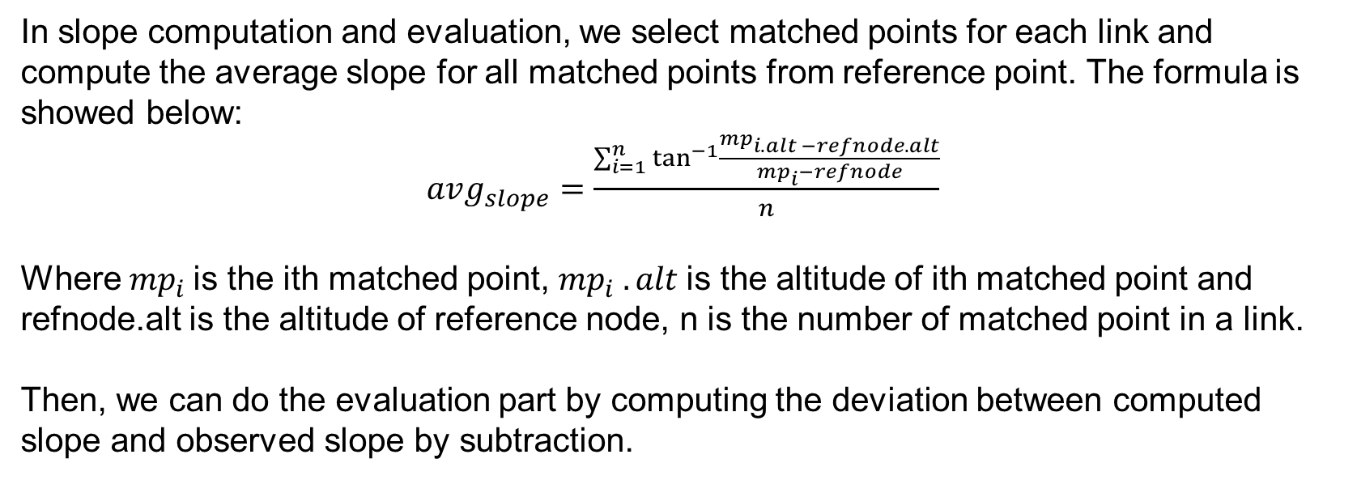
Algorithm Implementation: slope computation and evaluation
In slope computation and evaluation, we select matched points for each link and compute the average slope for all matched points from reference point. The formula is showed below:
$avg_{slope}=\frac{\sum_{i=1}^{n}{\tan^{−1}{\frac{{mp}_{i.alt −refnode.alt}}{{mp}_{i}−refnode}}}}{n}$
Where ${mp}_{i}$is the ith matched point, ${mp}_{i} .alt$is the altitude of ith matched point and refnode.alt is the altitude of reference node, n is the number of matched point in a link.
Then, we can do the evaluation part by computing the deviation between computed slope and observed slope by subtraction.

Slide 15
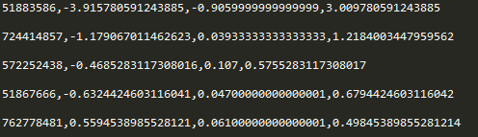
Algorithm Implementation: slope computation and evaluation
Result:
The result is stored in a csv file in the same directory of the program after running the program. The feature in the file is linkID, computed slope, observed slope and deviation.
Part of result is showed below:
Example of result of slope computation and evaluation

Slide 16
Conclusion and Findings
The ST Matching algorithm has good performance in map-matching, however, the algorithm is slow when dealing with huge amount of data since the time complexity is 𝑂(𝑛𝑘²𝑚 log 𝑚 + 𝑛𝑘²).
We may accelerate the processing speed by using distributed system

Slide 17
Reference
1. Yin Lou, Chengyang Zhang, Yu Zheng, Xing Xie, Wei Wang, and Yan Huang, Map-Matching for Low-Sampling-Rate GPS Trajectories, Acm Sigspatial International Symposium on Advances in Geographic Information Systems, 2009 :352-361

